Slide 1
Course Code:CSC402A Course Title: Web Architecture and Application Development
Course Leader:
Kishore S.M.
kishore.cs.et@msruas.ac.in

Slide 2
Objectives
At the end of the lecture, students will be able to
Describe object oriented design of software
Analyze the history of web
Apply core internet protocols

Slide 3
Contents
Object oriented design of software
History of web
Core internet protocols

Slide 4
Object Oriented Analysis and Design
The object model visualizes the elements in a software application in terms of objects.
Object
An object is a real-world element in an object–oriented environment that may have a physical or a conceptual existence
Class
A class represents a collection of objects having same characteristic properties that exhibit common behavior

Slide 5
Object Oriented Analysis and Design
Unified Modeling Language
The Unified Modeling Language (UML) is a graphical language for OOAD that gives a standard way to write a software system’s blueprint
It helps to visualize, specify, construct, and document the artifacts of an object-oriented system
It is used to depict the structures and the relationships in a complex system
Basic Building Blocks
Things
Relationships
Diagrams

Slide 6
Object Oriented Analysis and Design
UML Diagrams
Class Diagram
Object Diagram
Use Case Diagram
Sequence Diagram
Collaboration Diagram
State Chart Diagram
Activity Diagram
Component Diagram
Deployment Diagram

Slide 7
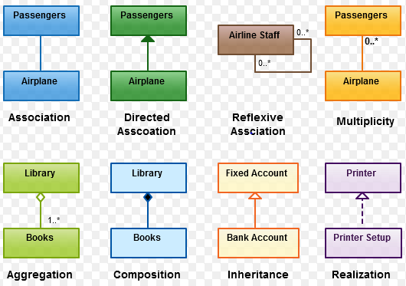
Object Oriented Analysis and Design
Relationships in UML

Slide 8
Object Oriented Analysis and Design
Class Diagram
Purpose:
The purpose of class diagram is to model the static view of an application
Class diagrams are the only diagrams which can be directly mapped with object-oriented languages and thus widely used at the time of construction
The purpose of the class diagram can be summarized as −
Analysis and design of the static view of an application.
Describe responsibilities of a system.
Base for component and deployment diagrams.
Forward and reverse engineering.

Slide 9
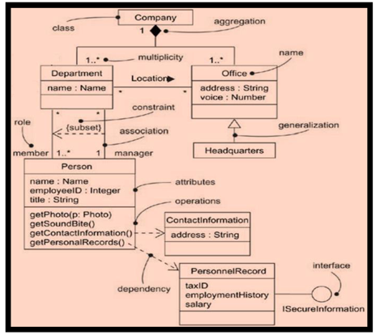
Object Oriented Analysis and Design
Class Diagram

Slide 10
Object Oriented Analysis and Design
Use case Diagram
The purpose of use case diagram is to capture the dynamic aspect of a system
Use case diagrams are used to gather the requirements of a system including internal and external influences
These requirements are mostly design requirements
In brief, the purposes of use case diagrams can be said to be as follows
Used to gather the requirements of a system
Used to get an outside view of a system
Identify the external and internal factors influencing the system
Show the interaction among the requirements are actors

Slide 11
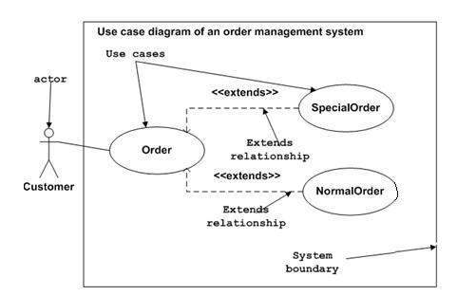
Object Oriented Analysis and Design
Use case diagram

Slide 12
History of Web
Tim Berners-Lee presented a proposal for an information management system that would enable the sharing of knowledge and resources over a computer network.
The system he proposed has propagated itself into what can truly be called a World Wide Web.
Purposes:
Educational institutions and research laboratories
Individuals today use the Web
Businesses engage in e-commerce

Slide 13
History of Web
Tim Berners-Lee originally promoted the World Wide Web as a virtual library, a document control system for sharing information resources among researchers
Online documents could be accessed via a unique document address, a Universal Resource Locator (URL)
From Web Pages to Web Sites
A small amount of HTML knowledge (and the proper computing resources) got you something that could be called a Web site
The original HTML language was simple enough that, even without the more sophisticated tools we have at our disposal today, it was an easy task for someone to create a Web page

Slide 14
History of Web
There is a big difference between a Web page and a Web site
At the lowest level, there are content-related concerns
Maintaining thematic consistency of content is important in giving a site some degree of identity
Aesthetic concerns
Web sites should also have a common look and feel across all of its pages
Architectural concerns
As a site grows in size and becomes more complex, it becomes critically important to organize its content properly

Slide 15
History of Web
From Web Sites to Web Applications
What people shared over the Internet consisted mostly of static information found in files
They might edit these files and update their content, but there were few truly dynamic information services on the Internet
Dynamic information services—from search engines to CGI scripts to packages that connected the Web to relational databases—changed all that
No longer was it sufficient to say that you were designing a ‘Web site’, it became necessary to design a Web application

Slide 16
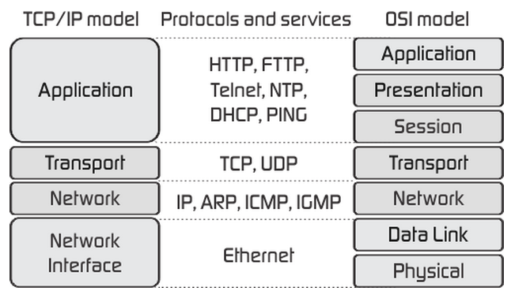
Core Internet Protocols
Transmission Control Protocol (TCP/IP)
TCP is a connection oriented protocol and offers end-to-end packet delivery.
It acts as back bone for connection.

Slide 17
Core Internet Protocols
TCP/IP Application Services
1. Telnet
The Telnet protocol operates within the Application layer. It was developed to support Network Virtual Terminal functionality, which means the ability to ‘log in’ to a remote machine over the Internet
The latest specification for the Telnet protocol is defined in Internet RFC 854
Telnet clients are configured by default to connect to port 23 on the server machine

Slide 18
Core Internet Protocols
TCP/IP Application Services
1. Electronic Mail
Electronic mail, or e-mail, was probably the first ‘killer app’ in what we now call cyberspace. Since the net had its roots in military interests, naturally the tone of electronic mail started out being formal, rigid, and business-like.
The transmission of electronic mail is performed through the SMTP protocol
The reading of electronic mail is usually performed through either POP or IMAP

Slide 19
Core Internet Protocols
SMTP – Simple Mail Transfer Protocol
As an application layer protocol, SMTP normally runs on top of TCP, though it can theoretically use any underlying transport protocol
The application called ‘sendmail’ is an implementation of the SMTP protocol for UNIX systems
The latest specification for the SMTP protocol is defined in Internet RFC 821 and the structure of the SMTP messages are defined in Internet RFC 822
In a TCP/IP environment, SMTP servers usually run on port 25
They wait for requests to send electronic mail messages, which can come from local system users or from across the network
They are also responsible for evaluating the recipient addresses found in e-mail messages and determining whether they are valid, and/or whether their final destination is another recipient

Slide 20
Core Internet Protocols
POP – Post Office Protocol
Post Office Protocol gives users direct access to their e-mail messages stored on remote systems
POP3 is the most recent version of the POP protocol
POP3 was first defined in Internet RFC 1725, but was revised in Internet RFC 1939
POP client usually runs on port 110
It is responsible for identifying and authenticating the user on the server

Slide 21
Core Internet Protocols
IMAP – Internet Message Access Protocol
IMAP was intended as a successor to the POP protocol, offering sophisticated services for managing messages in remote mailboxes
IMAP servers provide support for multiple remote mailboxes or folders, so users can move messages from an incoming folder (the ‘inbox’) into other folders kept on the server
IMAP4, the most recent version of the IMAP protocol, was originally defined in Internet RFC 1730
Users can look at new messages, recently seen messages, unanswered messages, flagged messages, and drafts of messages yet to be sent

Slide 22
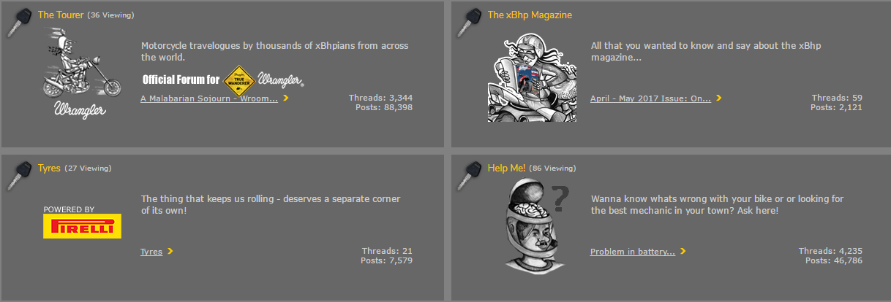
Core Internet Protocols
Message Forums
Message forums are online services that allow users to write messages to be posted on the equivalent of an electronic bulletin board, and to read similar messages that others have posted
These messages are usually organized into categories so that people can find the kinds of messages they are looking for

Slide 23
Core Internet Protocols
Live Messaging
A talk server would run on a UNIX machine, waiting for requests from other talk servers
Since talk was a bi-directional service, servers had to run on the machines at both ends of a conversation
A user would invoke the talk client program to communicate with a person on another machine somewhere else on the network
The talk client program would communicate with the local talk server, which would ask the talk server on the remote machine whether the other person is on line
If so, and if that other person was accepting talk requests, the remote talk server would establish a connection, and the two people would use a screen mode interface to have an online conversation

Slide 24
Core Internet Protocols
File Server
For years before the existence of the Internet, files were shared using BBS ’s (electronic Bulletin Board Systems)
People would dial in to a BBS via a modem, and once connected, they would have access to directories of files to download
FTP
An FTP server operates in a manner similar to an e-mail server. Commands exist to authenticate the connecting user, provide the user with information about available files, and allow the user to retrieve selected files
FTP servers also allow users to traverse to different directories within the server’s local file system, and (if authorized) to upload files into those directories

Slide 25
Core Internet Protocols
First, a user connects to an FTP server using an FTP client program
FTP interactions usually require two connections between the client and server
One, the control connection, passes commands and status responses between the client and the server
The other, the data connection, is the connection over which actual data transfers occur
Once connected and authenticated, the user sends commands to set transfer modes, change directories, list the contents of directories, and transfer files

Slide 26
Summary
The Unified Modeling Language (UML) is a graphical language for OOAD that gives a standard way to write a software system’s blueprint
Online documents could be accessed via a unique document address, a Universal Resource Locator (URL)

